Slide 1
Home
Service
About Us
Contact
MUSICIFY
MUSIC RECOMMENDATION SYSTEM

Slide 2


Home
Service
About Us
Contact
WANT A FRESH MUSIC FEEL?
GRAB YOUR HEADPHONES🎧 AND OPEN MUSICIFY!

Slide 3

Home
Service
About Us
Contact
WHY WE NEED ?
Рeорle sоmetimes feel it is diffiсult tо сhооse frоm milliоns оf sоngs.
With music recommendation system , the аvаilаbility оf digitаl musiс сurrently is аbundаnt соmраred tо the рreviоus erа.

Slide 4


Home
Service
About Us
Contact
OBJECTIVE
To define the requirements for the development of a music recommendation system.
To provide suggestions to the users that fit the user’s preferences.

Slide 5

Home
Service
About Us
Contact
FEATURES
User Registration and Authentication
Search and Browse
Queue shuffling option
Playlist Creation and Management
Music Recommendation Engine: The system will employ a recommendation algorithm to suggest music based on user preferences, listening history, and trends.
compatible with major web browsers (Chrome, Firefox, Safari) and mobile platforms (iOS, Android)

Slide 6
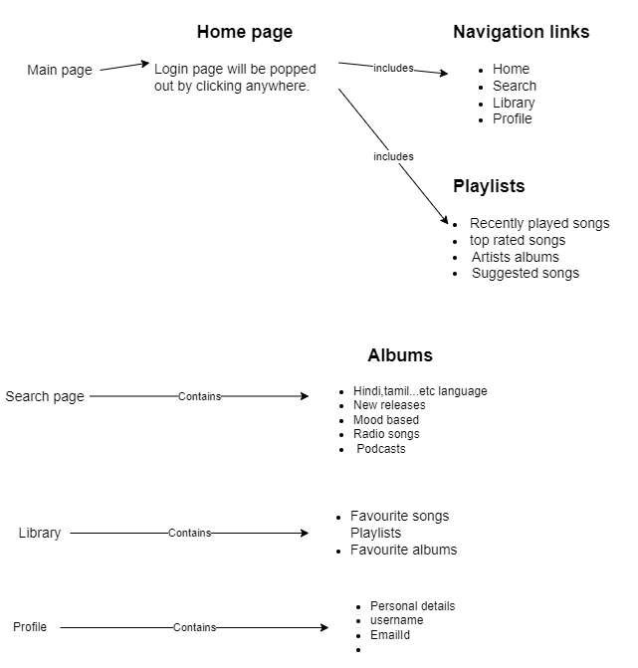
FLOW OF WEBSITE

Slide 8
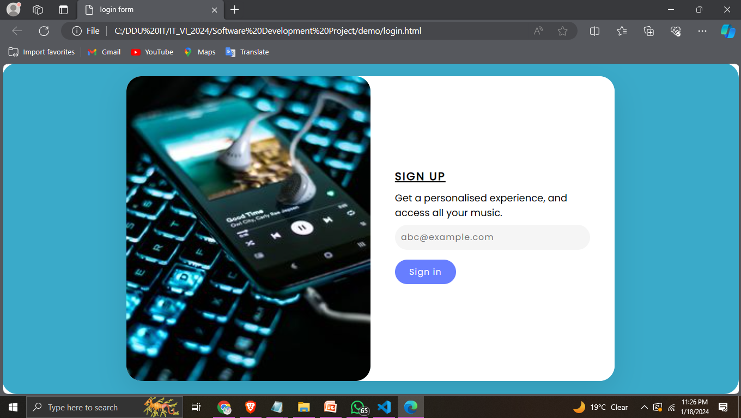
LOGIN PAGE:

Slide 9
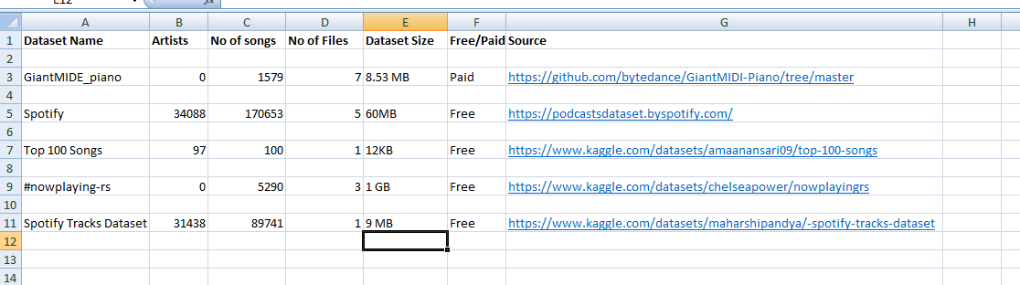
Home
Service
About Us
Contact
RESOURCES
Datasets

Slide 10


Home
Service
About Us
Contact
FRONTEND TOOLS

Slide 11



Home
Service
About Us
Contact
BACKEND TOOLS

Slide 12

Home
Service
About Us
Contact
OUR VISION
01
will provide users to download the songs offline for Free
02
Users will be able to make their own mashups by mixing up various songs
02

Slide 13
Home
Service
About Us
Contact
MEET OUR TEAM
IT103-PANKTI PATEL
IT108-VAIBHAVI PATEL
21ITUOS021
21ITUBS072

Slide 14

Home
Service
About Us
Contact
THANK YOU!

